Slide 1
Experiment 1
configuration of network device using packet tracer
Algorithm:
Configuration of network devices using packet:-
step1:-First select 6 pcs and 1hub.
step2:-Connect all pc’s to hub with connectors.
step3:-Give every pc’s by its own IP address like (ex:-193.212.1.1,193.212.1.2,........193.212.1.6).
step4:-Select message to one pc to another pc.
step5:-Now go to simulation and click the play.
step6:-We can observe the movement of messages.
step7:-Down we get that messages going correct or not if it is correct then it will display succesful ,if it is not correct then it will be in progress

Slide 2
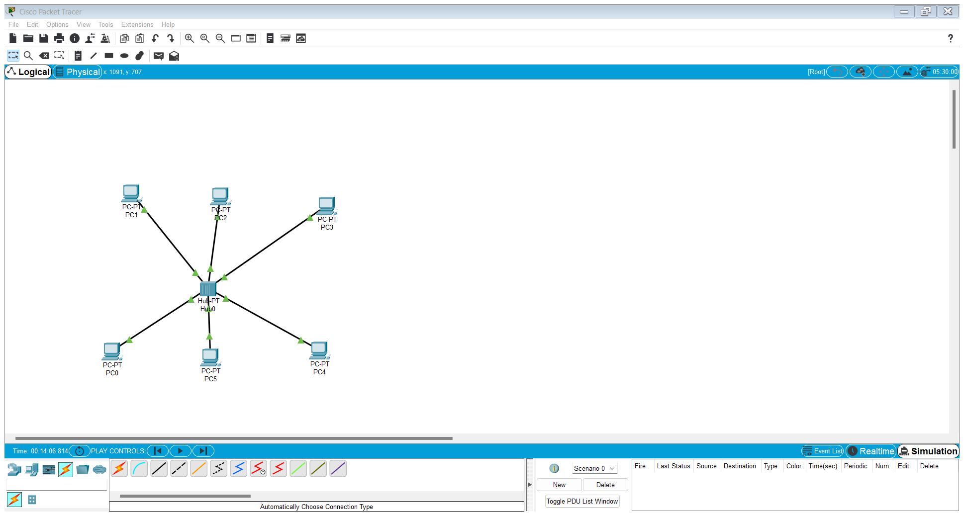

Slide 3
